Slide 1
Programming based on DOS and BIOS
INTERRUPTS – INT 21H AND INT 10H
Presented by
Briana Rajan
Hayden Cordeiro
Under the guidance of Prof. Sejal Chopra
Notes:
Be specific and direct in the title. Use the subtitle to give the specific context of the speech.
-The goal should be to capture the audience’s attention which can be done with a quote, a startling statistic, or fact. It is not necessary to include this attention getter on the slide.

Slide 2
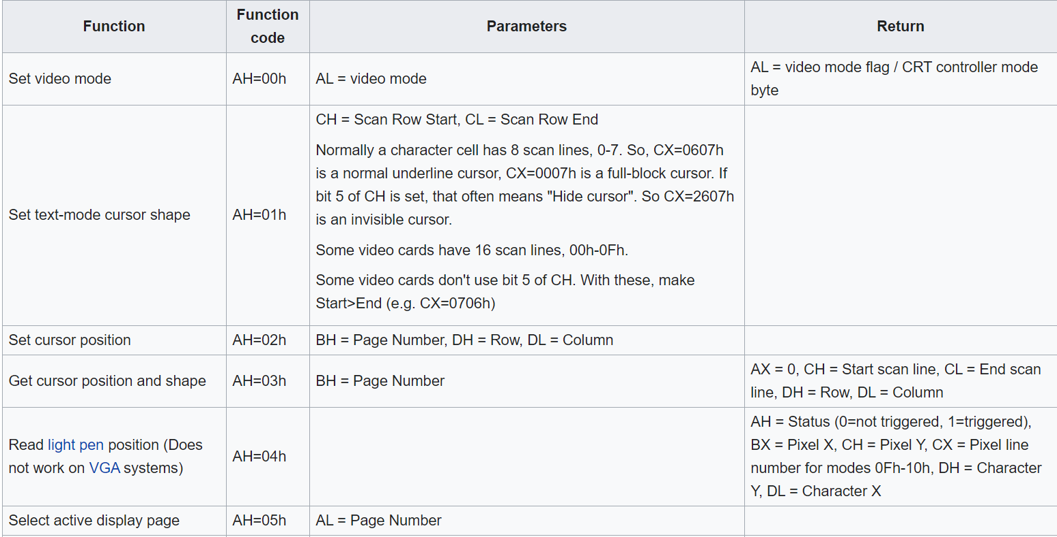
INT 10h
Video Service Interrupt
AH – select the video service provided
Al – mode of operation
Most use is to control the cursor on the monitor
Notes:
The title of main point #1 should be clear and concise. Each piece of evidence should be summarized for clarity and cited correctly. Do not simply read the pieces of evidence, but elaborate where needed.
[type notes for elaboration here]
Be sure to transition to main point #2 and the next slide.

Slide 3
INT 21H
Mov ah, 00h –To terminate program
-----------------------------------------------------------------------------------------------------------------------------------------------------------------------------------------------------------
Mov ah,4ch
Mov al, XX - To terminate the program, al decides if the control is to be returned to the parent program or OS – exit()
-----------------------------------------------------------------------------------------------------------------------------------------------------------------------------------------------------------
Mov ah,01 – Accept one char and echo- getche()
-----------------------------------------------------------------------------------------------------------------------------------------------------------------------------------------------------------
Mov ah, 07 –Accept one char
----------------------------------------------------------------------------------------------------------------------------------------------------------------------------------------------------------
Mov dl, value - To print a value
Mov ah, 02h
----------------------------------------------------------------------------------------------------------------------------------------------------------------------------------------------------------
Mov dx, offset of string - Print a string – puts()
Mov ah,09h

Slide 4
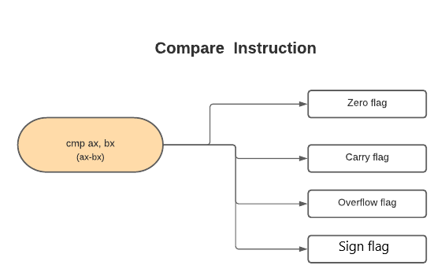
Compare Instruction

Slide 5
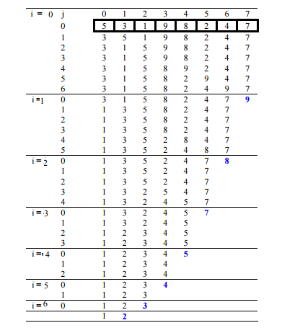
Bubble Sort

Slide 6
Bubble sorting in Higher Level Language void bubbleSort(int arr[], int n)
{
int i, j;
for (i = 1; i < n; i++)
// Last i elements are already in place
for (j = 1; j < n-i; j++)
if (arr[j] > arr[j+1])
swap(&arr[j], &arr[j+1]);
}

Slide 7
Programs
SI:
DI:

